Slide 1
Three-body problem involved Jupiter
Xiaoyu He
Dec. 15, 2016

Slide 2
Outline
Sun-Earth-Jupiter
The simplest three-body problem
Kirkwood gap
Example of resonances in the solar system

Slide 3
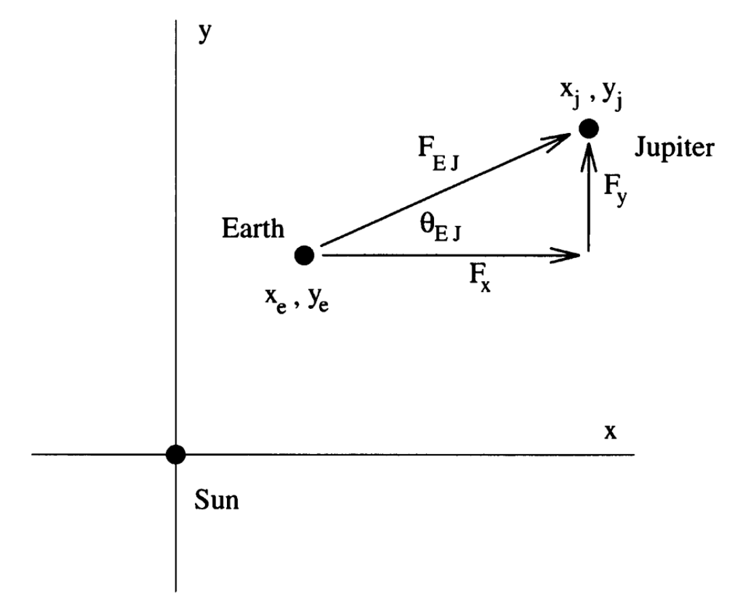
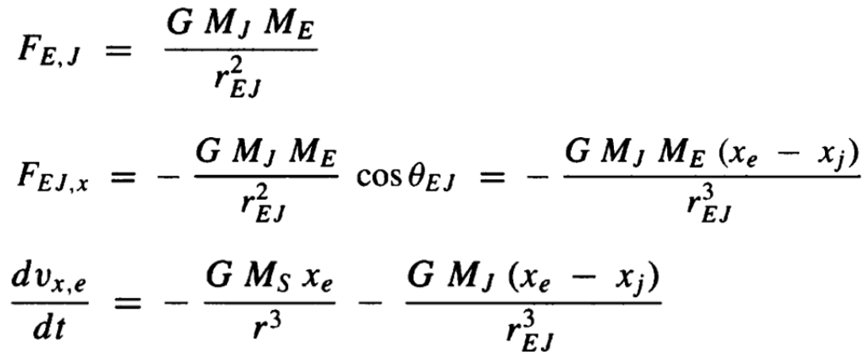
The Sun-Earth-Jupiter

Slide 4
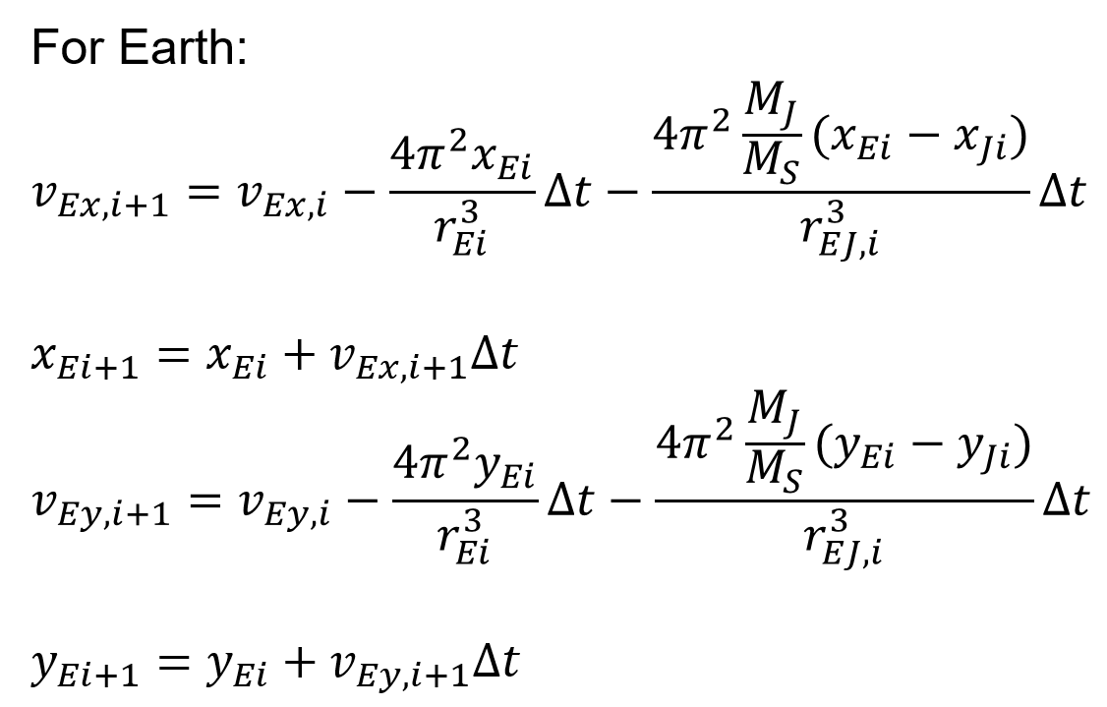
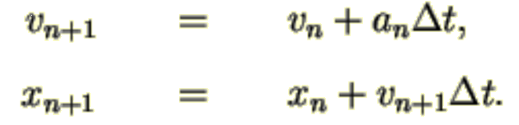
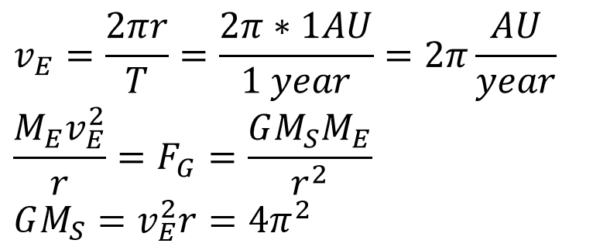
Euler-Cromer Method (Semi-implicit Euler Method)

Slide 5
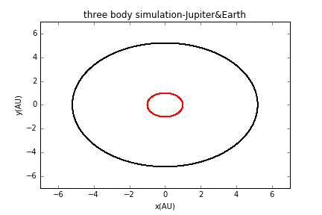
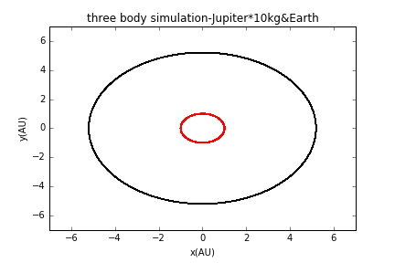
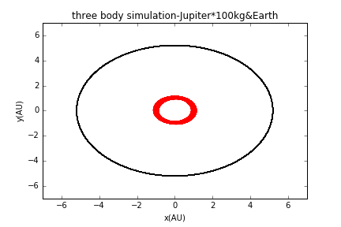
The orbits of Jupiter and Earth
Fig a. Jupiter has its true mass
Fig b. Jupiter has 10 times its true mass
Fig c. Jupiter has 100 times its true mass

Slide 6
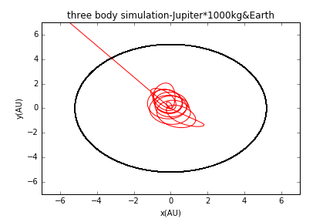
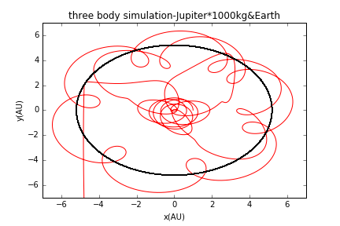
mass of Jupiter is quite large → Earth’s orbit completely unstable
Trajectory is very sensitive to the initial conditions
Jupiter has 1000 times its mass (different initial conditions)

Slide 7
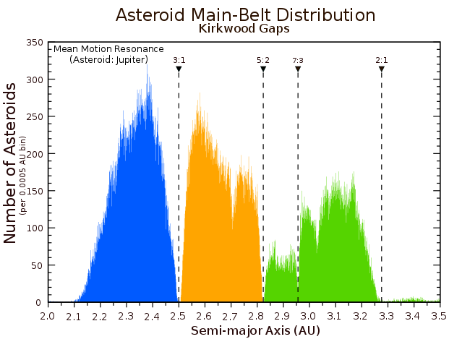
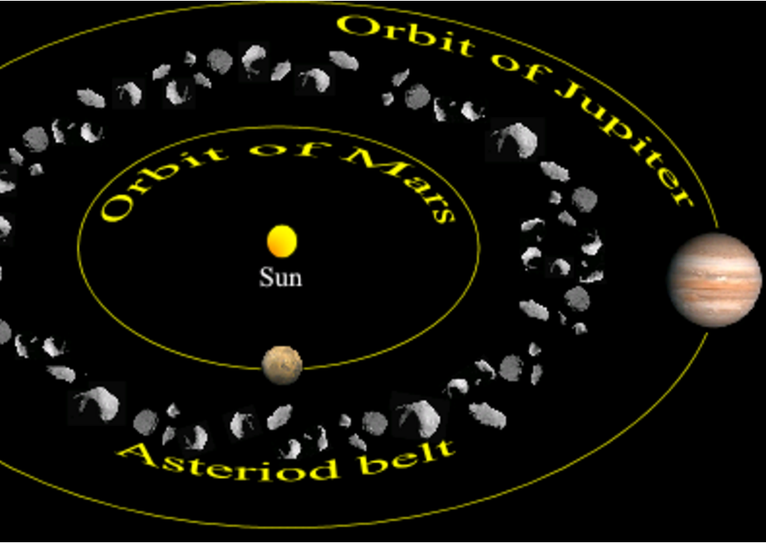
Kirkwood gap
The orbit radius of gap is in resonance with Jupiter

Slide 8
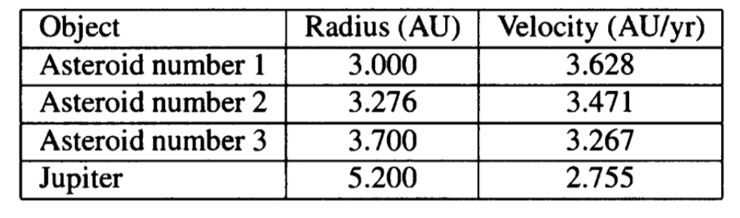
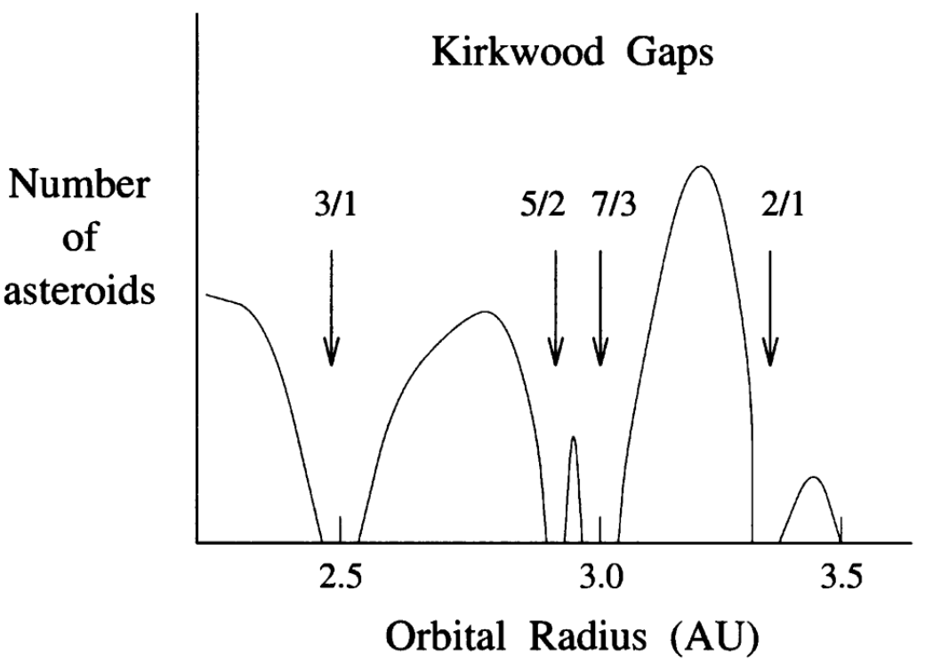
Asteroids in the vicinity of 2/1 Kirkwood gap
Note:
The mass of asteroid is quite small compared to the mass of Jupiter, thus we can neglect the gravitational force of each asteroid when computing the motion of Jupiter.(And ignore the interactions between asteroids.)

Slide 9
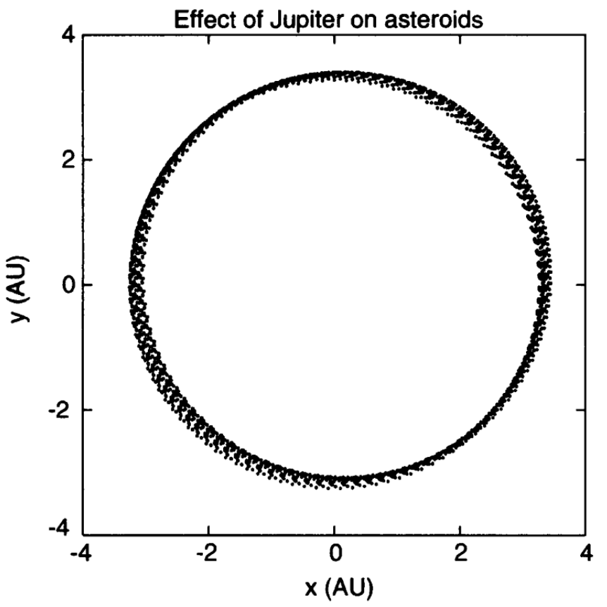
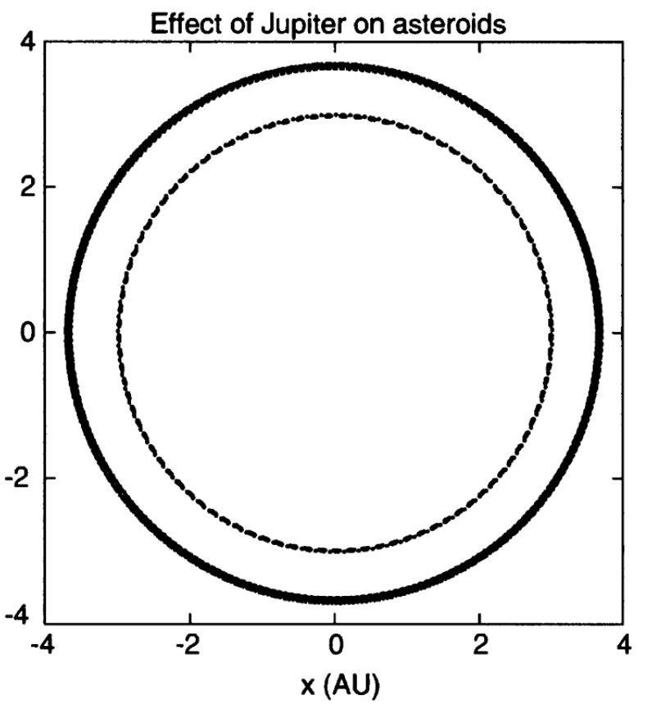
The asteroid in the 2/1 gap is the one affected most strongly by Jupiter
Fig a. The orbit of asteroid number 2
Fig b. The orbit of asteroid number 1 and 3

Slide 10
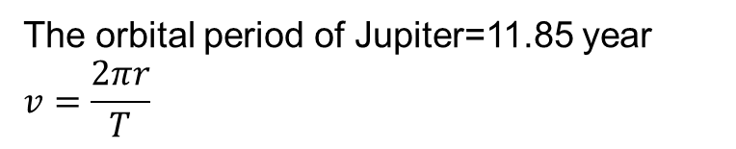
The table of Kirkwood gap
Resonance | Orbital Period(yr) | Orbital Radius(AU) | Orbital Velocity
3:1 | 3.95 | 2.5 | 3.977
5:2 | 4.74 | 2.825 | 3.745
7:3 | 5.08 | 2.95 | 3.649
2:1 | 5.925 | 3.276 | 3.471
The orbital period of Jupiter=11.85 year
$$v=\frac{2πr}{T}$$

Slide 11
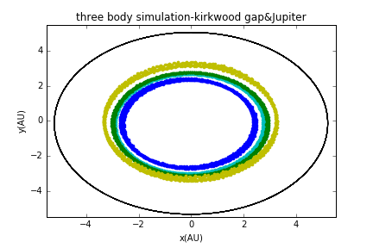
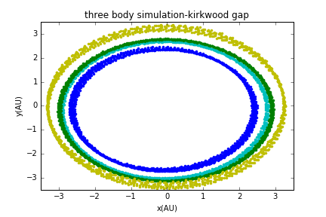
Fig a. The orbits of Jupiter and asteroids in Kirkwood gap
Fig b. The orbits of asteroids in Kirkwood gap

Slide 12
Thank you!

